Slide 1
Jonah Mondragon
February 19, 2021
Period 8

Slide 2
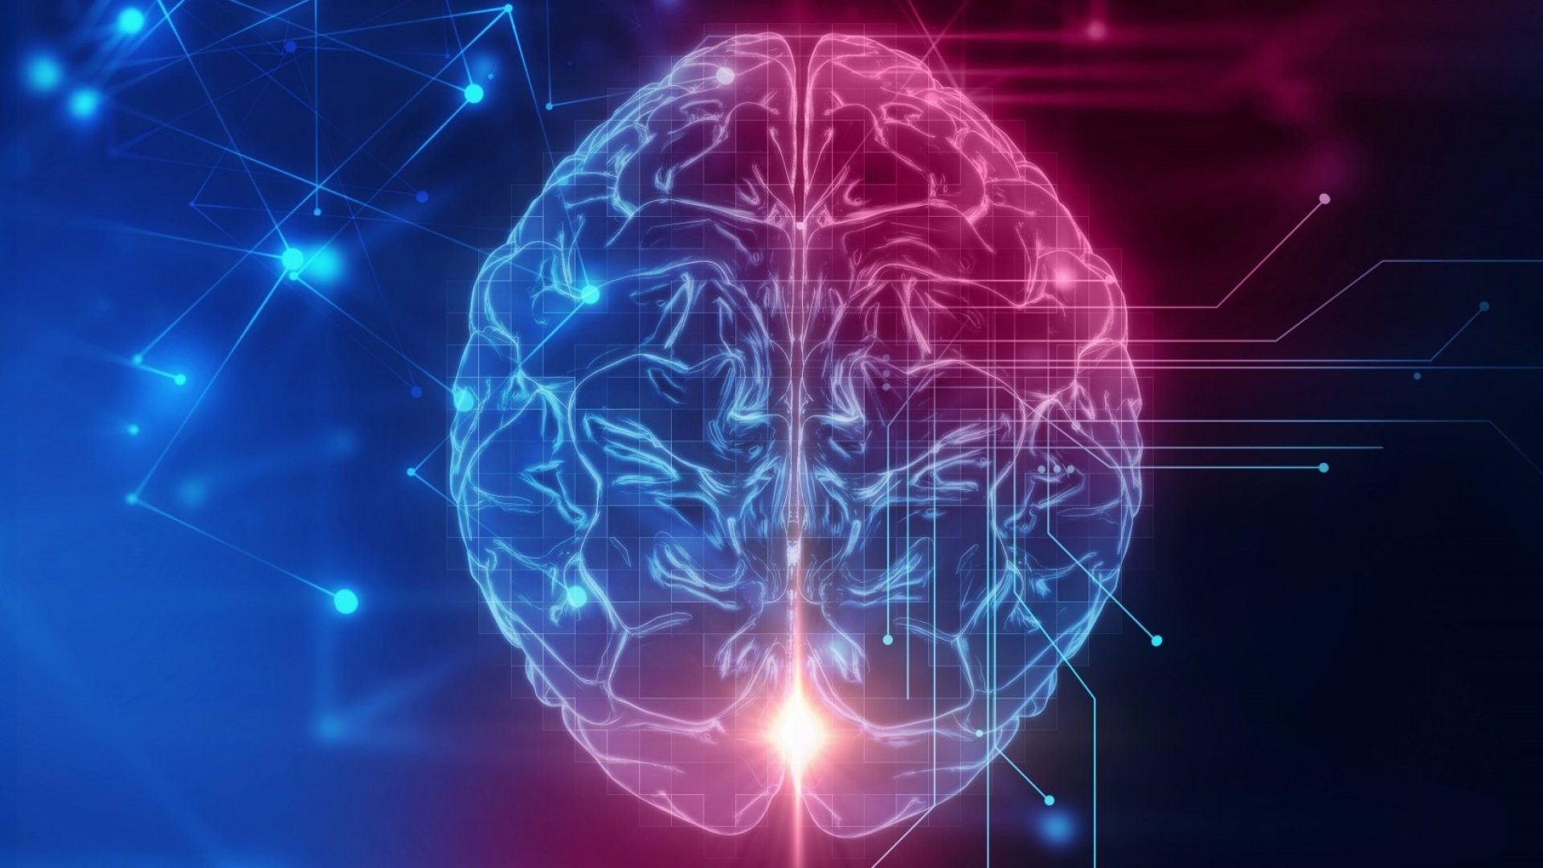
How do conditions of the brain
affect us Emotionally?
https://www.inc.com/jeff-haden/actually-people-with-larger-heads-really-do-tend-to-be-smarter-but-not-for-reason-you-might-think.html

Slide 3
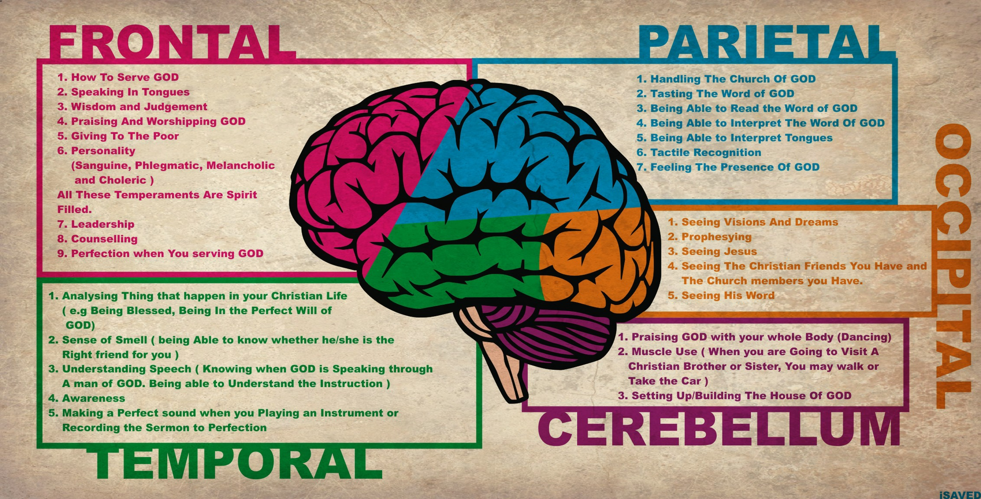
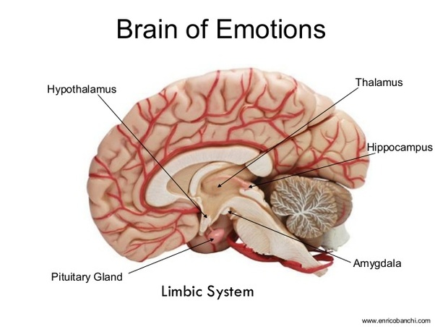
There are many areas of the brain effecting emotion.

Slide 4

Bipolar Disorder
Bipolar disorder affects a person's cognitive/functional ability; and puts them in a lapsing state of depression.
Solution
Therapy; cognitive behavioral therapy
Medications; anticonvulsant, antipsychotic; Hospitalization

Slide 5

Anxiety Disorder
Anxiety ensues depression, loss of libido, extreme fatigue.
Treatment
Self-care; therapies (including; cognitive behavioral therapy; meditation; and psychotherapy.); medications (antidepressants, sedatives, nerve-pain medication)
https://raisingchildren.net.au/pre-teens/mental-health-physical-health/stress-anxiety-depression/anxiety

Slide 6

Panic Disorder
Panic Disorder is disabling in most aspects of life; including hypervigilance, irritability, and restlessness.
Treatment
Relaxation; psychotherapy; medication (includes xanax, zoloft, and celexa)

Slide 7

Schizophrenia
Schizophrenia is, at its core, a type of psychopathy;
People with schioprenia encounter hallucinations, delusions, and thought disorder.
Treatment
Medication (including; antipsychotic, and anti-tremor); therapies (which include; rehabilitation, cognitive therapy psychoeducation, family therapy, behavior therapy)

Slide 8
References
1. https://www.webmd.com/brain/picture-of-the-brain#1
2. https://www.ncbi.nlm.nih.gov/books/NBK20369/
3. https://www.sciencedirect.com/science/article/abs/pii/S014067361500241X
4. https://www.healthline.com/health/anxiety/effects-on-body 5. https://www.mayoclinic.org/diseases-conditions/agoraphobia/symptoms-causes/syc-20355987 6. https://www.quantamagazine.org/to-pay-attention-the-brain-uses-filters-not-a-spotlight-20190924/ 7. https://pronghornpsych.com/how-does-anxiety-affect-the-brain/
8. https://www.google.com/search?q=Bipolar+disorder&oq=Bipolar+disorder&aqs=chrome.0.69i59l2j69i61j69i60. 5212j0j1&sourceid=chrome&ie=UTF8#wptab=s:H4sIAAAAAAAAAONgVuLQz9U3MEw3KnzE6Mgt8PLHPWEpi0lrTl5jNOLiCs7IL3fNK8ksqRRS4WKDsqS4eKTgmjQYpLi44DyeXUwCHqmJOSUZIUWpiSW5qXklxYtYpZ0yC JzEosUUjKL84tSUosUSuCyAAT67bmBAAAA
9. https://www.google.com/search?q=anxiety+disorder&oq=anxiety+disorder&aqs=chrome.0.69i59l2.3422j0j1& sourceid=chrome&ie=UTF-8#wptab=s:H4sIAAAAAAAAAONgVuLQz9U3SCspLnrE6Mgt8PLHPWEpi0lrTl5jNOLiCs7IL3fNK8ksqRRS4WKDsqS4eKTgmjQYpLi44DyeXUwCHqmJOSUZIUWpiSW5qXklxYtYpR3zKjJTSyoVUjKL84tSUosUSuCyAMlQCXCBAAAA
10. https://www.google.com/search?q=Schizophrenia&oq=Schizophrenia&aqs=chrome..69i57.4001j0j1&sourceid= chrome&ie=UTF-8#wptab=s:H4sIAAAAAAAAAONgVuLQz9U3MKsoLHzE6Mgt8PLHPWEpi0lrTl5jNOLiCs7IL3fNK8ksqRRS4WKDsqS4eKTgmjQYpLi44DyeXUwCHqmJOSUZIUWpiSW5qXklxYtYJYKTMzKr8gsyilLzMhMVSuBSAFvJyz5-AAAA 11. https://www.nimh.nih.gov/health/topics/schizophrenia/index.shtml

